Slide 1
Bioinformatics in Python
Pandas & Data Visualization

Slide 2
What’s Bioinformatics?
With advances in technology, healthcare is experiencing a deluge of new data
such as a patient’s genome sequence, electronic medical records, or the complete genomic and metabolic characterization of a tumor
This information has the potential to provide key insights into disease and treatment
Bioinformatics involves harnessing data science and machine learning methods to organize and derive insights from this diverse information

Slide 3
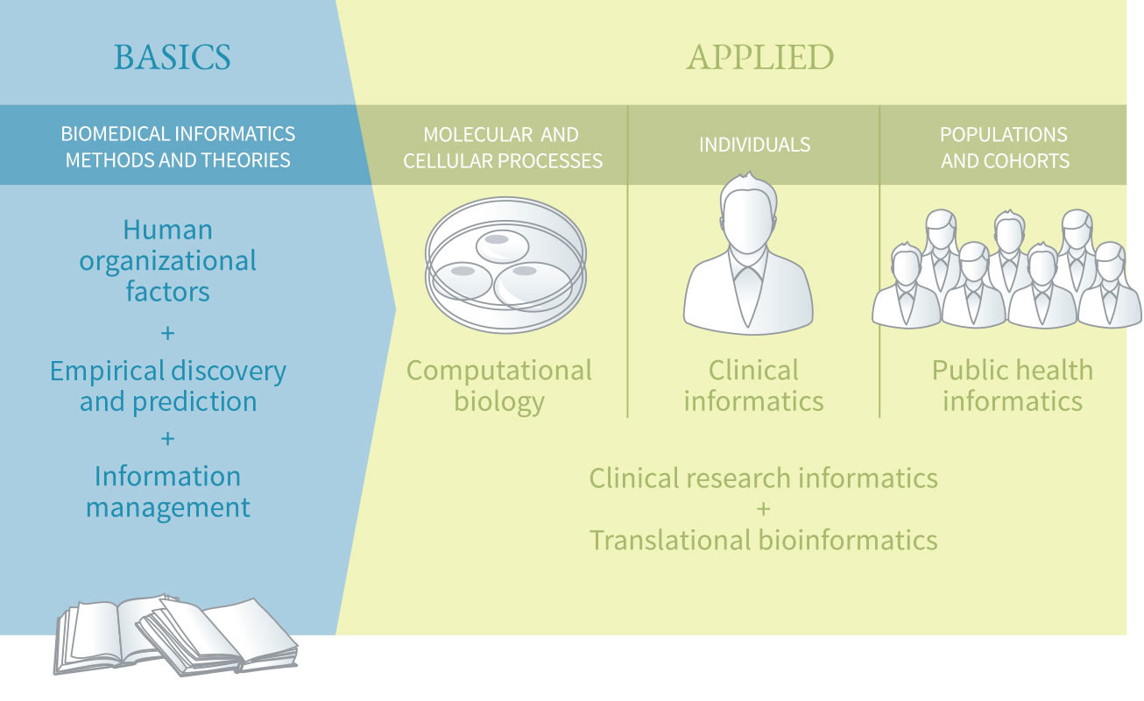

Slide 4
The Cancer Genome Atlas
TCGA is a project to catalogue genetic mutations responsible for cancer.
Begun by the National Cancer Institute and the National Human Genome Research Institute in 2006.
They characterized over 20,000 primary cancers.
Generated over 2.5 petabytes of genomic, epigenomic, transcriptomic, and proteomic data.

Slide 5
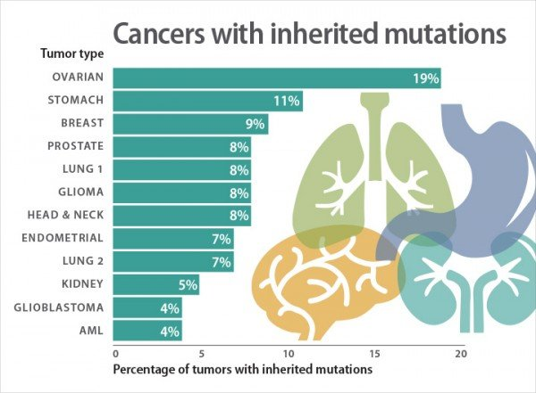
Lung Adenocarcinoma
The most common type of lung cancer, usually starts in the mucus linings
Let’s use Python to look at a subset of the TCGA for genes linked to LUAD

Slide 6
iPython!
An interactive command-line terminal for Python
You can write one command at a time and get results instantly, instead of having a script that executes commands in order.
Great for exploring and visualizing data!
The Jupyter Notebook is a web-application that makes iPython prettier! Please install it if you haven’t already:
anaconda: https://www.anaconda.com/distribution/
jupyter: https://jupyter.org/install

Slide 7

Pandas?

Slide 8
Let’s try it!

Slide 9
Bibliography
https://www.dbmi.columbia.edu/about-dbmi/
https://www.cancer.org/cancer/non-small-cell-lung-cancer/about/what-is-non-small-cell-lung-cancer.html

